Slide 1
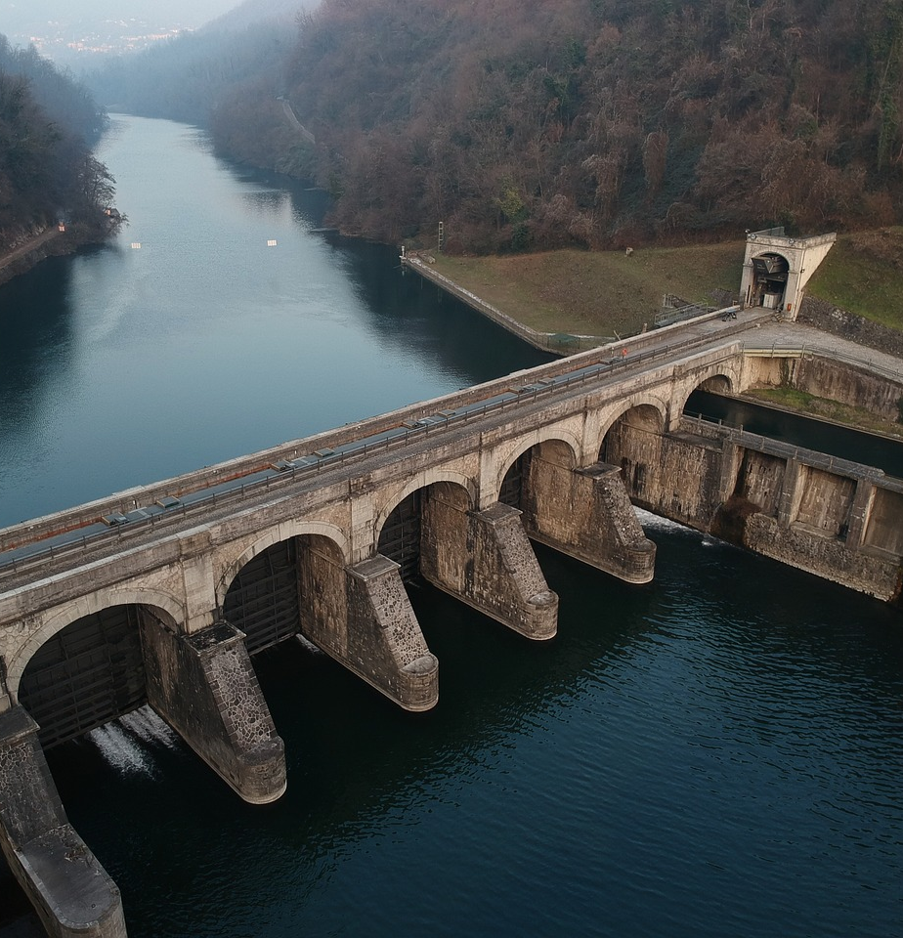
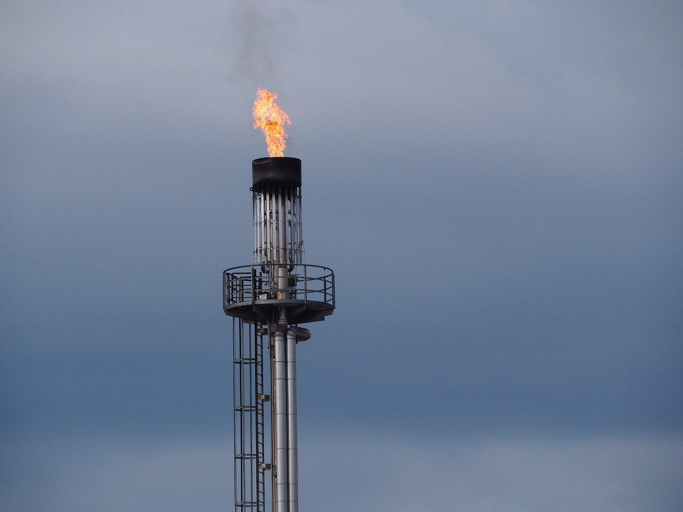
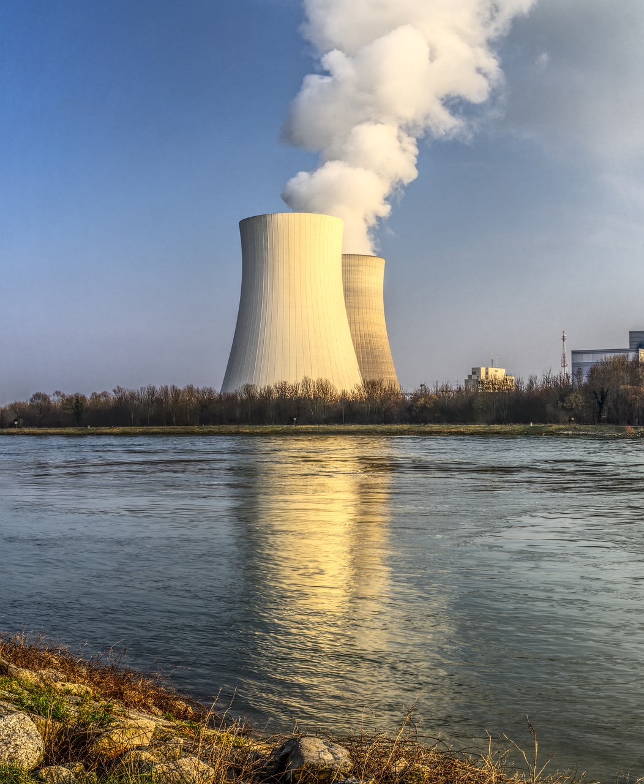


Pixabay by
Maja_Drone
Pixabay by
Ratfink1973
Pixabay by
atimedia
Pixabay by distelAPPArath
Pixabay by
McRonny

Slide 2








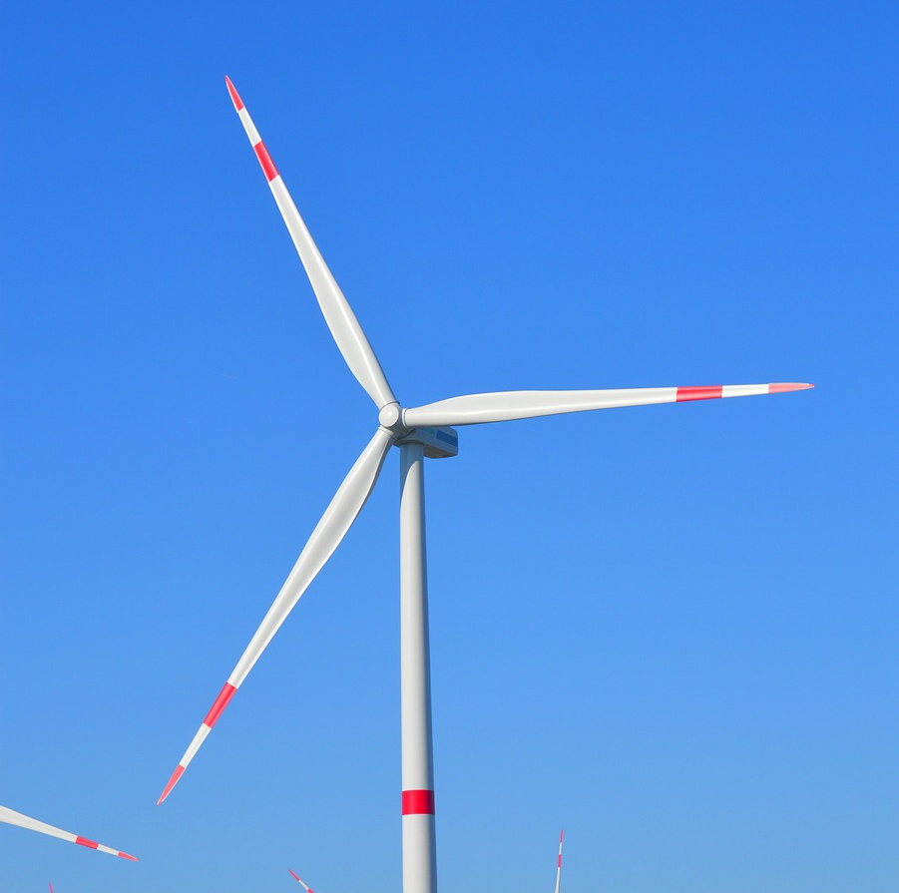
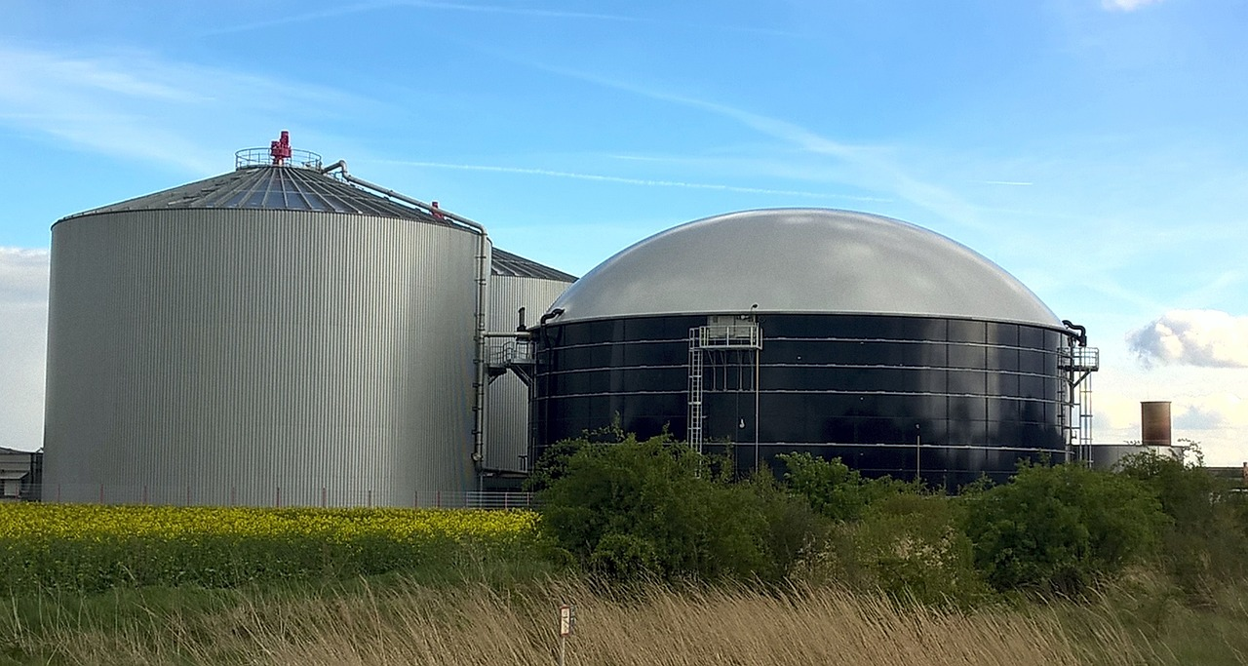
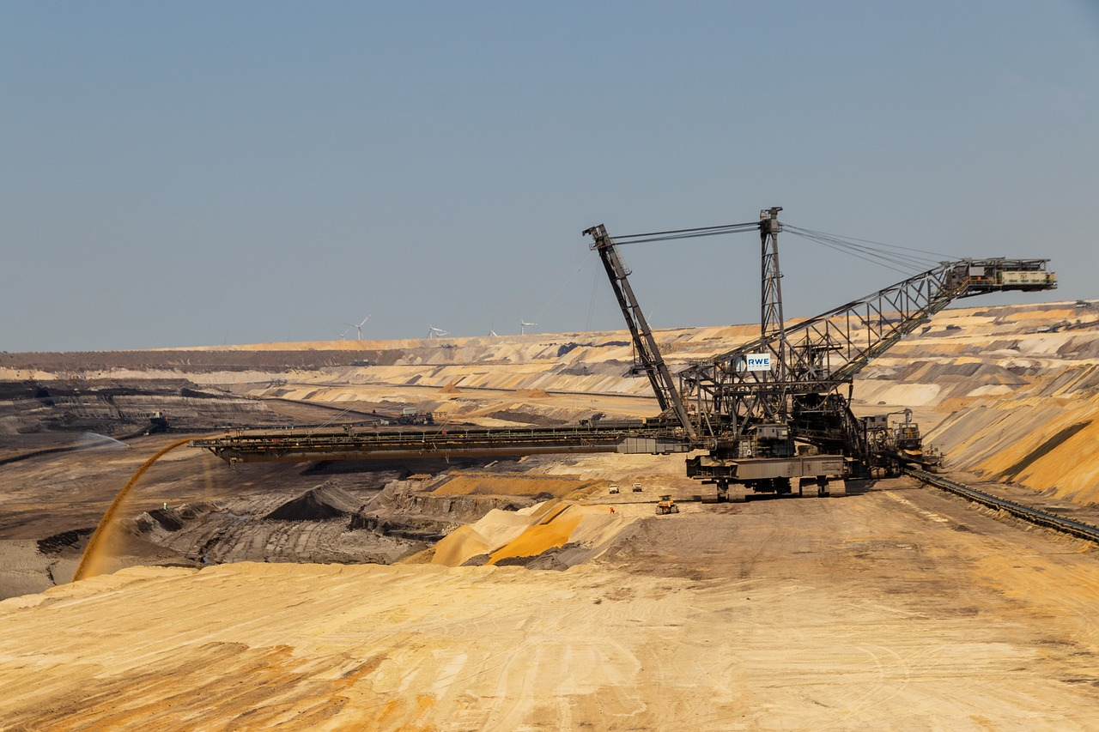
Pixabay by
neelam279
Pixabay by 1815691
Pixabay by herbert2512

